Slide 1
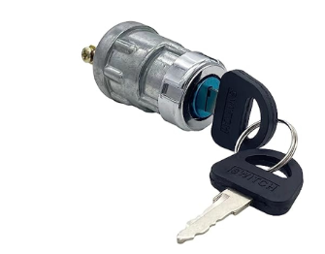
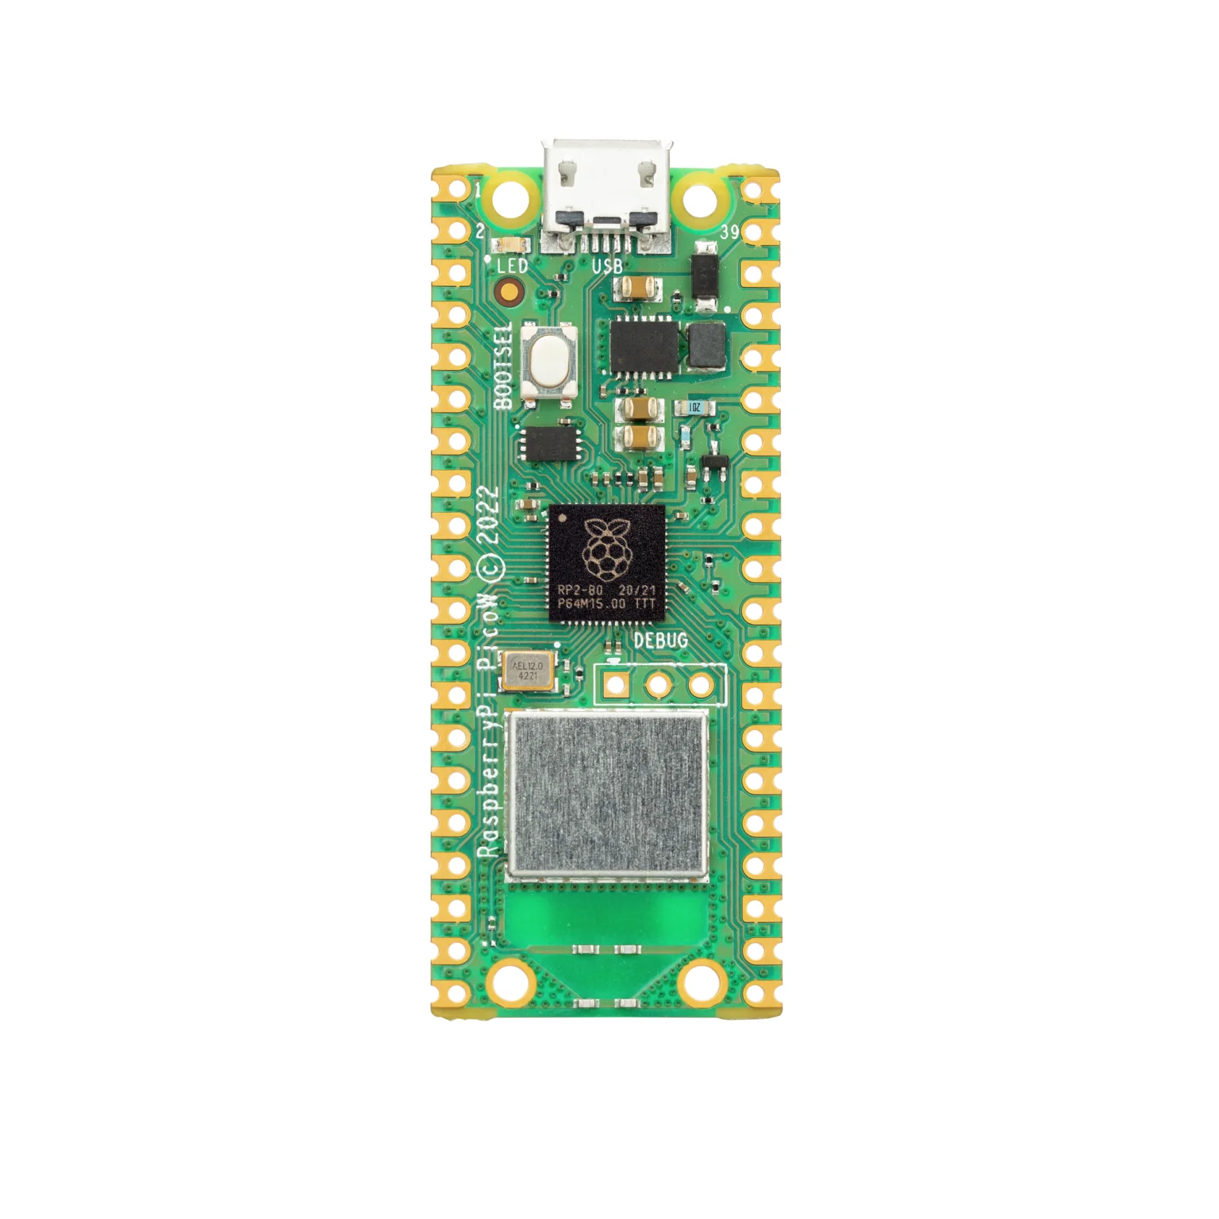
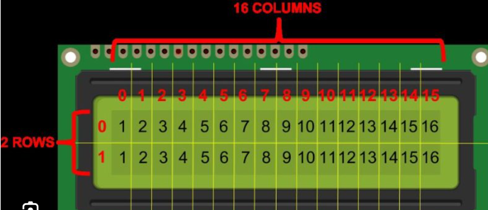
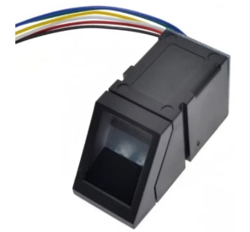
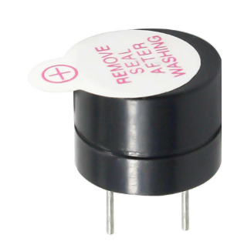
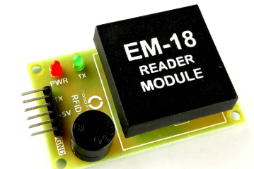
CAR IGNITION CONTROL WITH FINGERPRINT AND RFID USING RASPBERRY PI PICO
Ignition Control
イグニッションせいぎょ
LCD Display
エルシーディー ディスプレイ
Fingerprint Authentication
しもん にんしょう
Buzzer
ブザー
RFID CARD DETECTION
アールエフアイディー カード けんしゅつ
Presented by:
Munnam Bhavya
23P31A04H1
でんしつうしんこうがく(ECE)
アディティア大学
RASPBERRY PI PICO
ラズベリーパイ ピコ

Slide 2
OBJECTIVE
License and Fingerprint Check: Scans the driver’s license and fingerprint to ensure they match authorized data.
Ignition Control: Starts the car only if both the license and fingerprint are correct.
Theft Alert: Notifies the owner if an unauthorized person tries to start the car.
License Expiry Reminder: Prevents ignition if the driver's license has expired.
This integrated approach addresses critical vulnerabilities in traditional vehicle security systems, such as key theft or duplication, by introducing multiple layers of authentication.

Slide 3
METHODOLOGY
RFID Reader (DL Card)
(Driver's License)
Raspberry PI PICO
(Processing Unit)
(Data Verification)
Fingerprint Scanner
(Fingerprint match)
RFID Data Comparison
(Authorized?)
Ignition Control (Ignition/Off)
GSM Module (SMS Alert)
(Unauthorized Access, License Expiry Alert)
Unauthorized Access (Alert)
Ignition Activated
(Car Starts)
SMS Notification to
Vehicle Owner

Slide 4
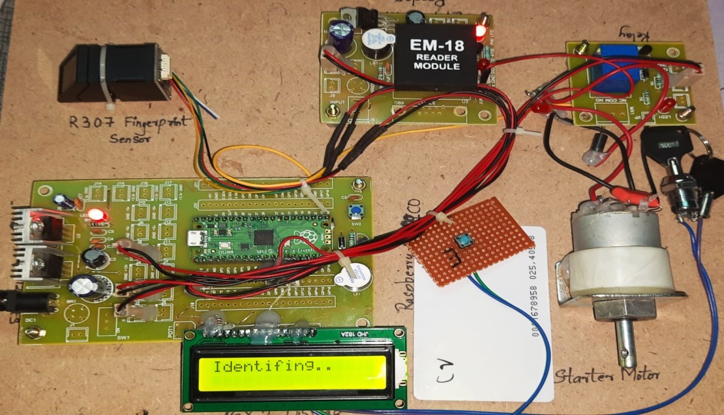
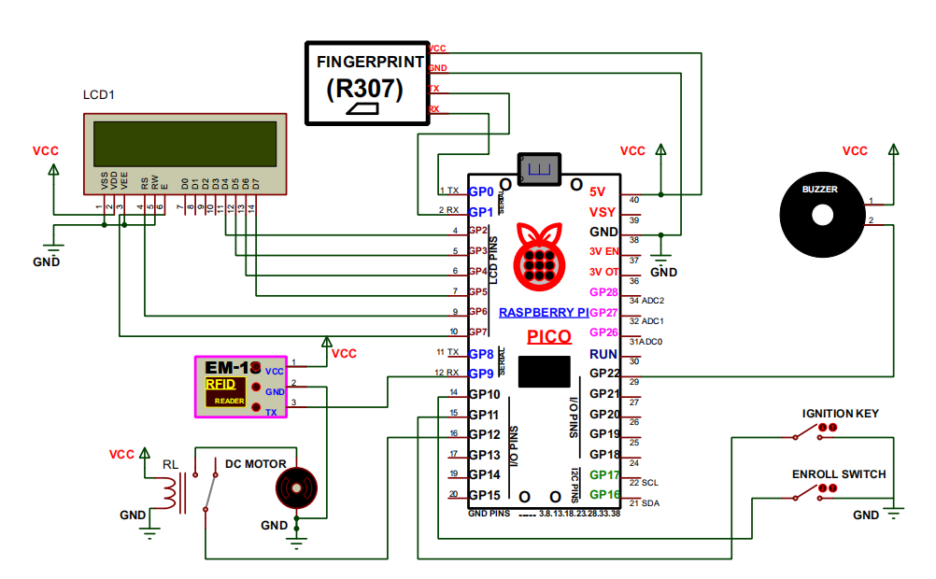
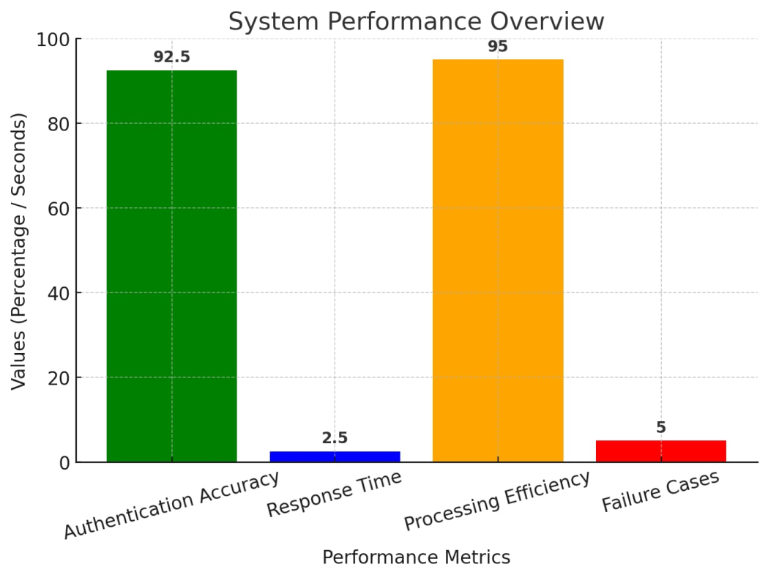
SCHEMATIC DIAGRAM
RESULTS
Fig.2. Ignition Control System Activation
Fig.1. Ignition Control System using Proteus
Fig.3. System Performance Overview

Slide 5
CONCLUSION AND FUTURE SCOPE
Authentication Accuracy: 90-95% success rate with minimal errors.
Response Time: RFID & fingerprint verification within 2-3 seconds.
Processing Efficiency: Low power consumption, instant relay activation.
Failure Cases: Minor false rejections due to finger misplacement.
Comparison: More secure than key-based & RFID-only ignition systems.
CONCLUSION
FUTURE SCOPE
Enhanced Security with AI-Based Authentication.
Integration with IoT for Remote Monitoring
Expansion to Multi-Vehicle Access Systems

Slide 6
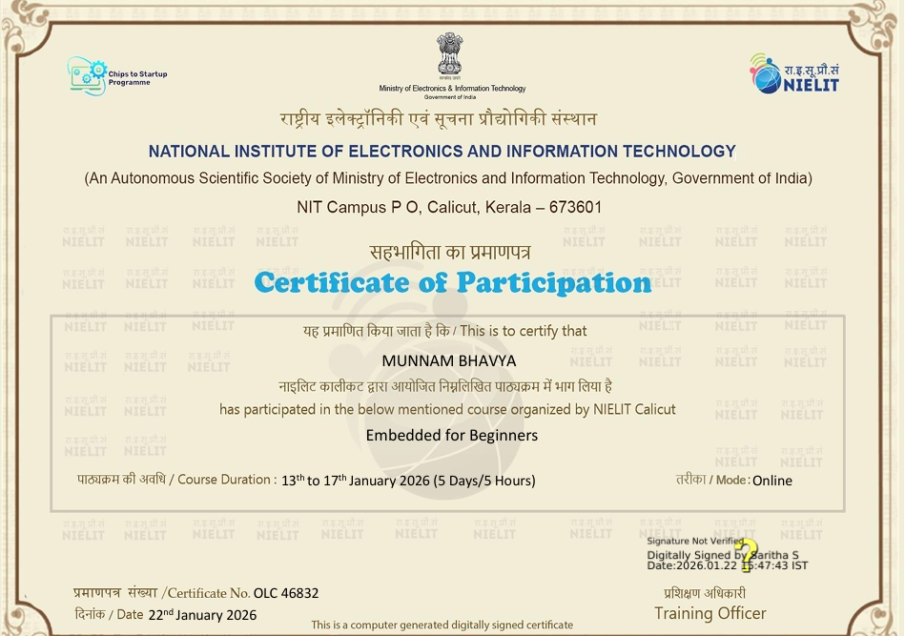


GITHUB : https://github.com/BhavyaMunnam
LINKEDIN : https://www.linkedin.com/in/munnam-bhavya-72451a300/

Slide 7

ありがとうございます

